Slide 1
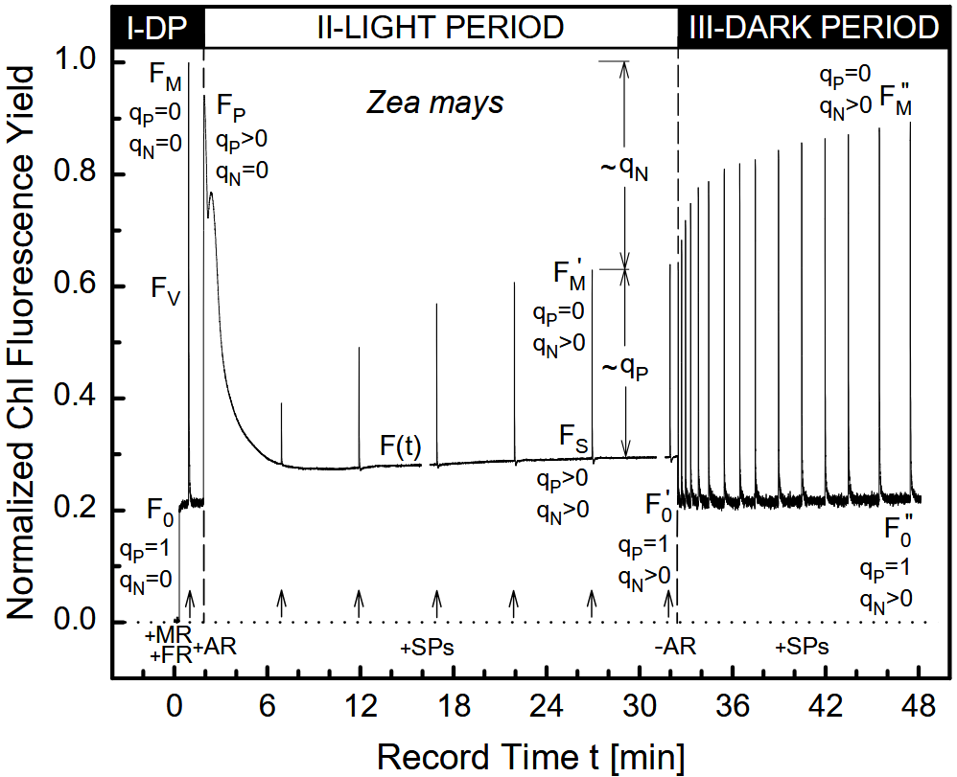
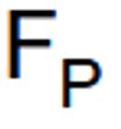


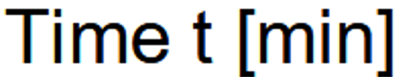
F_{m}
F_{m}'_{D2}
F_{m}'_{D1}
F_{d}
F_{m}'
F_{m}'
F_{v}'

Slide 2
State 1
State 2
State 1
NPQ
State 1
State 2
NPQ

Slide 3
Blue AL:
State 1
Red AL:
State 2
Blue AL:
State 1
Strong Blue
AL: NPQ
F_{m (max)}
F_{m}'
F_{t}

